Slide 1
Blood Share Hub
Guide name : Dr.L.DHANABAL
Submitted By,
Sriram S (23MCA058)

Slide 2
OBJECTIVES
Facilitate Blood Donation: Enable hospital to easily request blood donations and allow donors to quickly respond to these requests, ensuring a steady supply of blood for patients in need.
Real-Time Communication: Provide a platform for real-time communication between hospital and donors, ensuring that requests and responses are handled promptly and efficiently.
User-Friendly Interface: Create a user-friendly interface for both donors and hospital, making it easy to navigate and use the platform to request or donate blood.
Ensure Timely Donations: Enable hospital to receive blood donations in a timely manner, reducing the risk of shortages and ensuring that patients receive the care they need.
Support Healthcare Systems: Support healthcare systems by providing a reliable and efficient platform for managing blood donations, ultimately saving lives and improving patient outcomes..
Promote Awareness: Raise awareness about the importance of blood donation and encourage more people to donate blood regularly, contributing to a sustainable supply of blood for healthcare systems.
Conducting Camps: Organize and conduct blood donation camps to encourage voluntary blood donations and increase awareness about the need for regular blood donations.

Slide 3
HARDWARE REQUIREMENT
Processor : 12th Gen Intel(R) Core(TM) i5-1235U 1.30 GHz
Hard Disk : 10 GB
RAM : 500 GB

Slide 4
SOFTWARE REQUIREMENT
Operating System :Windows 11
Front End : HBS, CSS
Back End : Node.js, Express
Database :MongoDB

Slide 5
EXISTING SYSTEM
Relies on manual processes and traditional communication, causing delays in receiving blood donations.
Difficulty in maintaining an up-to-date donor database, leading to challenges in quickly identifying suitable donors.
Lack of effective communication and awareness for blood donation camps, resulting in low turnout and wasted resources.
Inefficient organization of blood donation camps without proper promotion or notification mechanisms.
Lack of centralized platform for tracking the success of camps and following up with donors, impacting blood supply consistency.

Slide 6
PROPOSED SYSTEM
The proposed system will serve as a bridge between blood donors and hospital. It allows hospital to send notifications when they require blood, and donors can easily respond to these requests.
The platform facilitates seamless communication and coordination between donors and hospital, ensuring timely and efficient blood donations.
Features include real-time notifications, donor profiles, and hospital requests, creating a user-friendly experience for both donors and hospital.
Users can also book appointments in hospitals. This feature enhances the user experience by providing a convenient way to schedule blood donation appointments.
Users can track where their donated blood is used after donation, providing transparency and motivation for regular donations.

Slide 7
MODULES
Login page
Visit Profile
Request donor
Respond to request
Conduct blood camps

Slide 8
MODULES
Login Page:
Customer login: Lets users securely log in to their accounts, accessing personalized features and services.
Admin login: Provides access to the admin dashboard, allowing administrators to manage the website effectively.
Visit Profile:
Donor profile: Displays donor information, including blood type, contact details, and donation history. Donors can update their profiles.
Admin profile: Displays administrator information and allows admins to update donor profiles.
.

Slide 9
Request Donor:
Donor request submission: Allows hospital to submit requests for blood donations, specifying the required blood type and quantity.
Donor matching: Matches donor profiles with the specified request criteria, aiding in quick donor selection and coordination.
Respond to Request:
Donor response form: Allows donors to respond to blood donation requests, indicating availability and willingness to donate.
Confirmation notification: Sends a confirmation to the hospital once a donor agrees to donate, providing contact information for coordination.
Conduct Blood Camps:
Camp organization: Lets administrators schedule and organize blood donation camps, specifying location, date, and time.

Slide 10
DATA FLOW DIAGRAM
Level 0
Blood Share Hub
Donor
Admin

Slide 11
Level 1
Login
Donor
Donor_Db
View profile
Donor
Respond
Donor
Register Camp
Donor

Slide 12
Level 1(Continue)
Login
Admin
Admin_Db
View profile
Admin
Request
Admin
Conduct Camp
Admin

Slide 13
Admin Collection
Hospital Model
Request Model
{
_id: ObjectId (Primary Key),
email: String,
password: String,
H_name: String,
appointments: [
{
id: String,
date: String,
name: String,
bloodGroup: String,
status: String
} ],
place: String
}
{
_id: ObjectId (Primary Key),
hospitalName: String,
hospitalAddress: String,
hospitalDistrict: String,
patientId: String,
phoneNumber: Number,
dateNeeded: String,
bloodGroup: String,
purpose: String,
responseId: String
}

Slide 14
Admin Collection
{
_id: ObjectId (Primary Key),
hospitalId: String,
bloodInventory: {
'O+': [
{
id: String,
status: String,
expiryDate: Date
}
],
'Others': [
{
bloodGroup: String,
id: String,
status: String,
expiryDate: Date
}]}
}
Hospital Inventory Model

Slide 15
Donor Collection
Donor Model
Camp Model
{
_id: ObjectId (Primary Key),
name: String,
email: String,
phno: String,
bloodGroup: String,
password: String,
age: Number,
district: String,
donatedTimes: Number,
last_donate: String,
weight: Number,
status: Number,
last_edit: Date,
image: String
}
{
_id: ObjectId (Primary Key),
date: String,
district: String,
phoneNumber: String,
time: String,
place: String,
response: {
Morning: [String],
Afternoon: [String],
Evening: [String]
},
startTime: String,
endTime: String,
campId: Number
}

Slide 16
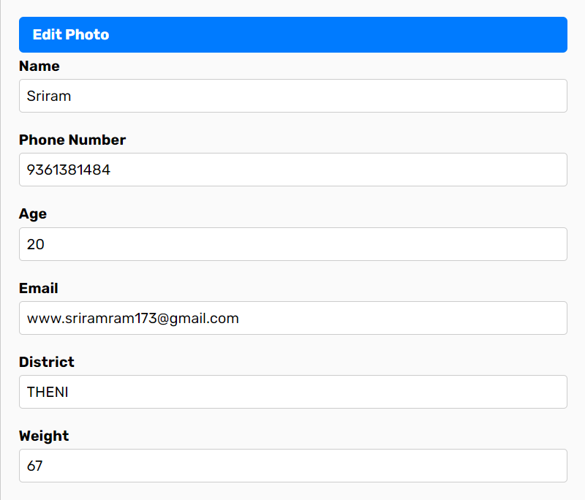
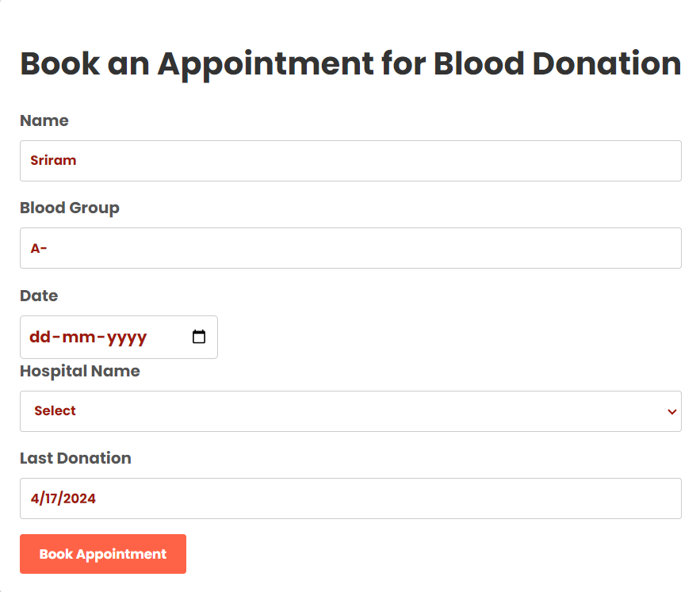
Forms Design

Slide 17
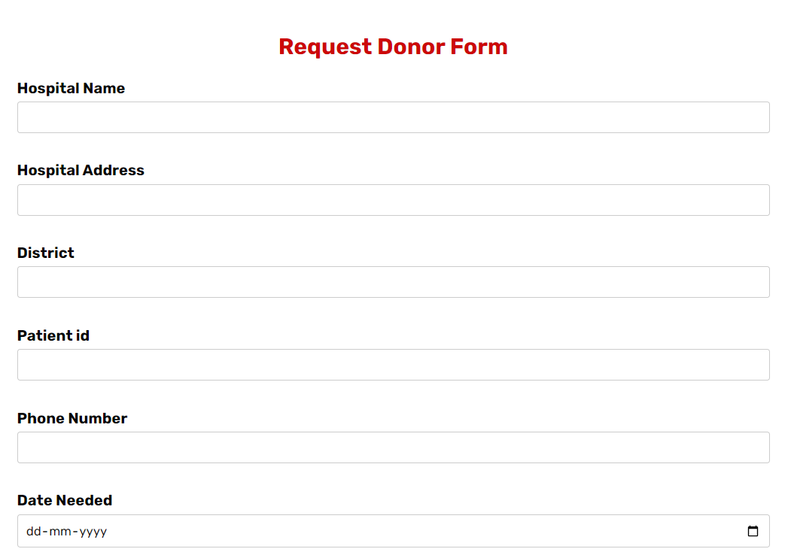
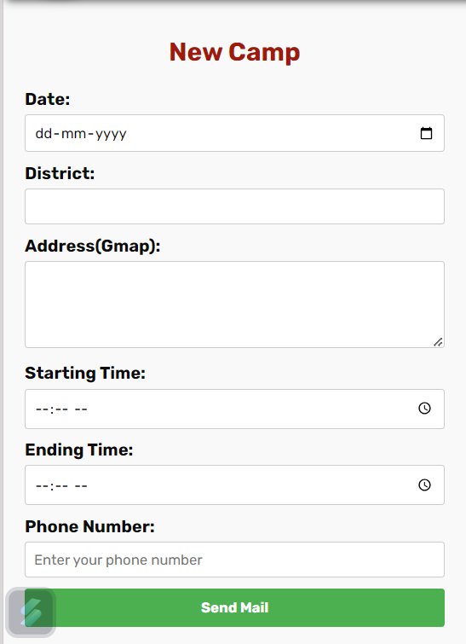
Forms Design

Slide 18
OUTCOME OF THE PROJECT
The outcome of your "Blood Share Hub" project will be a user-friendly web application that effectively bridges the gap between blood donors and hospital.
The platform will streamline the blood donation process by providing hospital with a centralized system to request blood donations and allowing donors to easily respond to these requests.
Key features such as real-time notifications, donor profiles, and hospital requests will enhance communication and coordination, ensuring timely and efficient blood donations.
Overall, the "Blood Share Hub" will play a crucial role in improving access to blood donations, saving lives, and supporting healthcare systems.

Slide 19
References
References
https://www.w3schools.com/mongodb/
https://www.npmjs.com/
https://rb.gy/wqs1xp

